Slide 1
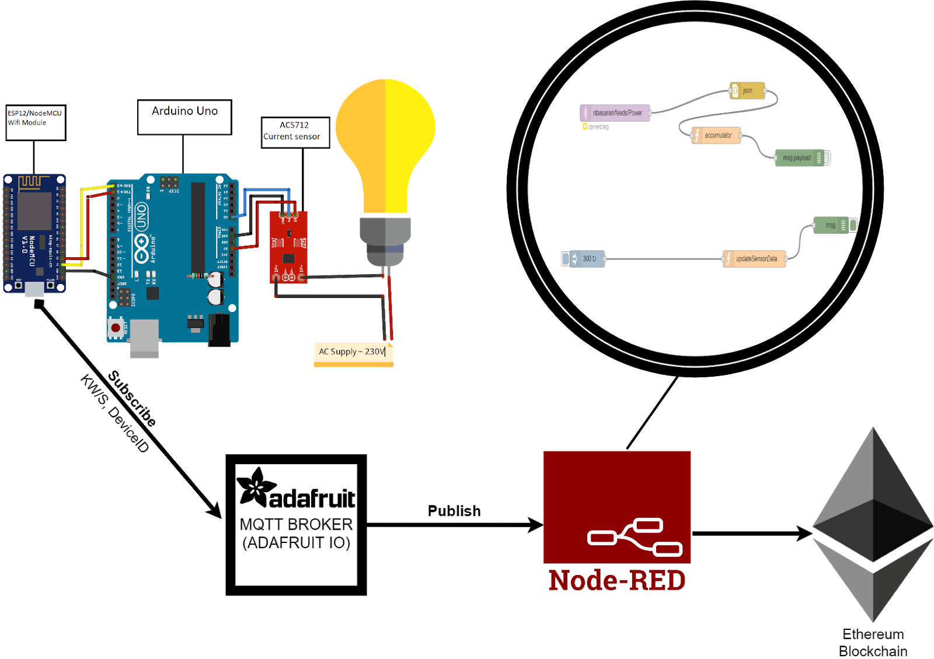
Smart Energy Metering and Blockchain Based Billing System
Team members:
Ceyhun Onur
Nebih Başaran
Solution:
Used ACS712 Sensor to retrieve Voltage and Power values from an AC device
Directed data through NodeMCU to Adafruit (MQTT Broker)
Node-red proccesses the data for blockchain smart contract
Smart Contract lets the consumer pay according to her/his power consumption from e-wallet.
Problem: Conventional Power Meters are outdated, Billing system is outdated, Wrong billings due to wrong readings
Technologies: Arduino Uno, ACS712 Current Sensor, NodeMCU ESP8266, Adafruit, Node-Red, Blockchain, Ethereum, Smart Contract
CmpE 490 IoT Course Final Project, 2019 Spring, Bogazici University Computer Engineering Department

